Slide 1
Programming for Psychologists
Lecture 5 October 1st 2018
http://osdoc.cogsci.nl

Slide 2
Some important points...
Variable names vs strings
“green” vs green (green can be “blue”)
A string is a value
Like any number, or True or False
A variable is a symbolic name that points or refers to a value (or object)
Variables resemble words to make it is easier for us humans to read and write code
Always ask yourself if you need to use quotes

Slide 3

Methods of placing stimuli
Random
Grid
Circle

Slide 4
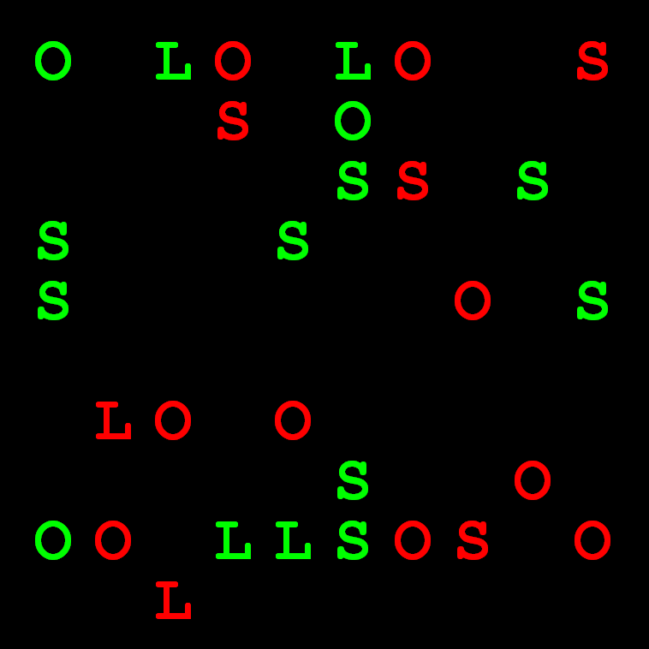
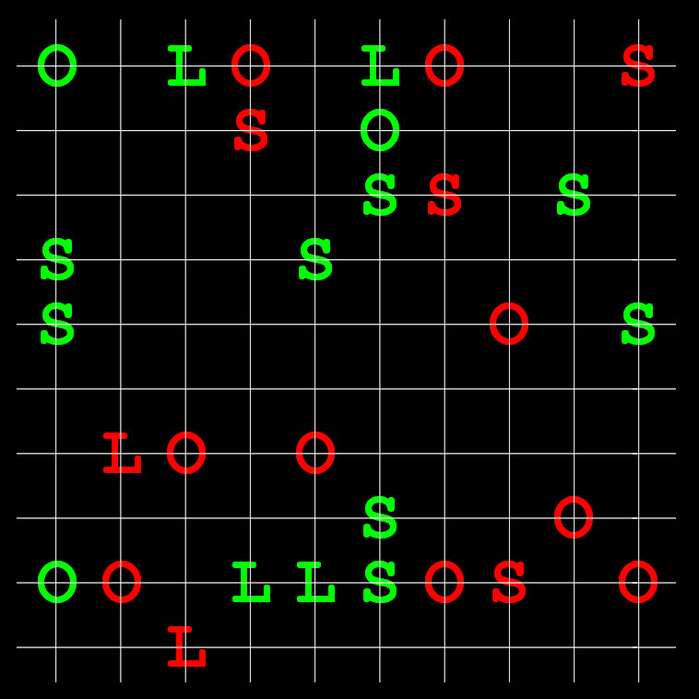
Stimuli placement: grid

Slide 5
Stimuli placement: grid
More control over placement
If a grid position is taken no other stimulus should be drawn at that spot
Each grid position has the same distance to its neighboring grid positions

Slide 6
Stimuli placement: grid
Placement on a grid:
Create all grid positions
Usually using two for loops (one for x, and one for the y coordinate)
Randomize grid positions
For element in all_elements:
Draw stimulus to grid position (element)

Slide 7


Creating grid positions
Decide on distance between grid positions (e.g. ll = 20)
Determine topleft most grid position and calculate all pos from there
Odd no. of grid positions (5x5)
Even no. of grid positions (4x4)
ll = 20
nr_grid = 4
ll = 20
nr_grid= 5
topleft_x = center_x – 0.5*nr_grid*ll + 0.5*ll
topleft_y = center_y – 0.5*nr_grid*ll + 0.5*ll

Slide 8
Creating grid positions
Pseudo code
start_x = calculate the leftmost x position of the grid
start_y = calculate the topmost y position of the grid
initiate an empty list to store grid positions
for i = 1 to nr grid positions
current_x = calculate x position for i’th position in x dimension
for j = 1 to nr grid positions
current_y = calculate y position for j’th position in y dimension
append current_x and current_y as a tuple to grid position list

Slide 9
Picking grid positions
Draw 20 letters on random grid positions
The hard solution!
import random letters = ("S","L","O") colors = ("red","green") taken_gridpositions = [] for i in range(0,20): letter = random.choice(letters) color = random.choice(colors) grid_pos = random.choice(gridpositions) while grid_pos in taken_gridpositions: grid_pos = random.choice(gridpositions) cnvs.text(letter, x=grid_pos[0], y=grid_pos[1],color=color) taken_gridpositions.append(grid_pos)

Slide 10
Intermezzo: the pop() function
Retrieve the last item of the list, and remove it from the list!
In combination with random.shuffle(), pop offers a very powerful functionality. import random myList = [1,2,3,4,5] random.shuffle(myList) #randomize order popped_item = myList.pop() # pop ? Item print "Item just popped is", popped_item print "myList now is", myList Output: Item just popped is 2 myList now is [3,5,1,4] (Different every time!)
Using pop() in combination with shuffle(), you can randomly pick items from a list and remove them at the same time

Slide 11
The pop() function
You can also call pop() with an index, which will pop the item at that position. myList = [1,2,3,4,5] popped_item = myList.pop(2) # pop 3rd item print "Item just popped is", popped_item print "myList now is", myList Output: Item just popped is 3 myList now is [1,2,4,5]

Slide 12
Filling a grid version 2
Draw 20 letters on random grid positions
import random
letters = (“S”,”L”,”O”)
colors = (“red”,”green”)
taken_gridpositions = []
for i in range(0,20):
letter = random.choice(letters)
color = random.choice(colors)
grid_pos = random.choice(gridpositions)
while grid_pos in taken_gridpositions:
grid_pos = random.choice(gridpositions)
cnvs.text(letter,x=grid_pos[0],y=grid_pos[1],color=color)
taken_gridpositions.append(grid_pos)

Slide 13
Filling a grid version 2
Draw 20 letters on random grid positions
The easy way
import random letters = (“S”,”L”,”O”) colors = (“red”,”green”) random.shuffle(gridpositions) for i in range(0,20): letter = random.choice(letters) color = random.choice(colors) grid_pos = gridpositions.pop() cnvs.text(letter,x=grid_pos[0], y=grid_pos[1],color=color)

Slide 14
Filling a grid version 3
Draw 20 letters on random grid positions
The easiest way
import random letters = (“S”,”L”,”O”) colors = (“red”,”green”) random.shuffle(gridpositions) for i in range(0,20): letter = random.choice(letters) color = random.choice(colors) grid_pos = gridpositions[i] cnvs.text(letter,x=grid_pos[0], y=grid_pos[1],color=color)

Slide 15
Another useful Python feat.
If you know the structure of a tuple, you can 'catch' its contents directly.
For instance, if I know a grid position will always and only consist of an (x,y) pair, instead of: grid_pos = gridpositions.pop()
cnvs.text(letter,x=grid_pos[0],y=grid_pos[1],color=color)
I could also type: (cur_x, cur_y) = gridpositions.pop()
exp.cnvs.text(letter, x=cur_x, y=cur_y, color=color)

Slide 16
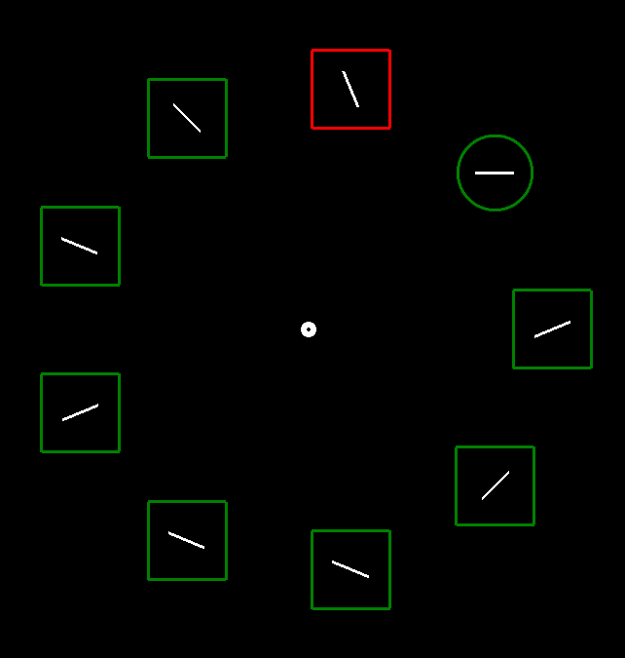
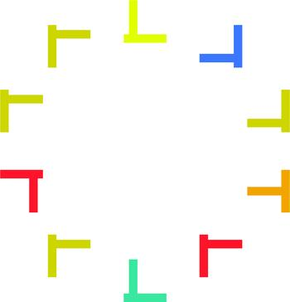
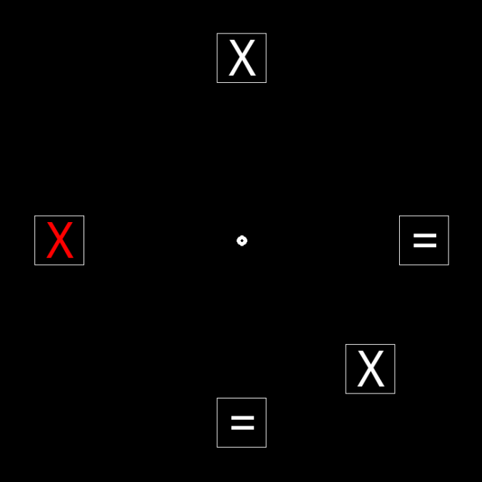
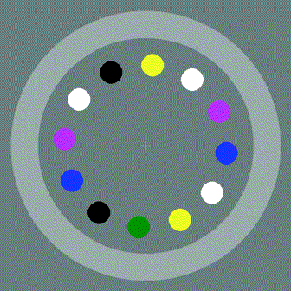
Stimuli placement: circle
Very common method for presenting stimuli

Slide 17
Placing stimuli in a circle
Benefits
All stimuli have equal eccentricity/distance to fixation point (i.e. middle of the circle)
Stimuli have equal distance to each other
Scalable
Limits
Only space for a limited number of items
For a very large number of items, grid layout might be better

Slide 18
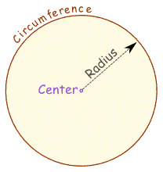
Placing stimuli in a circle
Properties of a circle
A circle has a radius, often indicated with r
A full circle is 2π radians (= 360º)
2π*r is circumference of circle

Slide 19
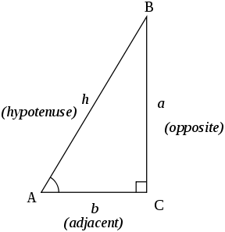
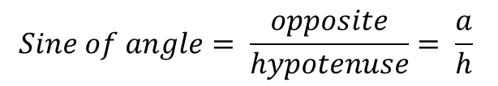
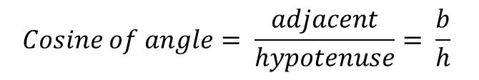
Calculating circle positions
Sine and Cosine
$$Cosine of angle= \frac{adjacent}{hypotenuse}= \frac{b}{h}$$
$$Sine of angle= \frac{opposite}{hypotenuse}= \frac{a}{h}$$

Slide 20
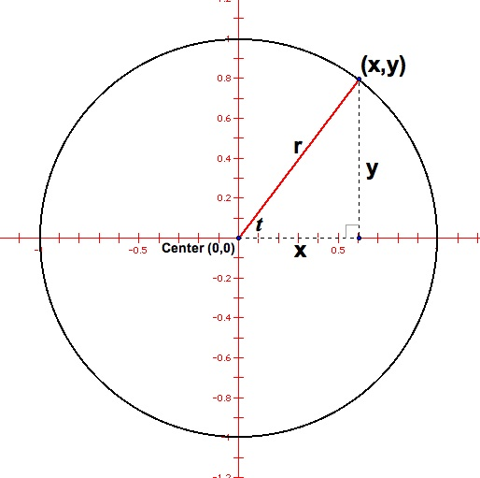
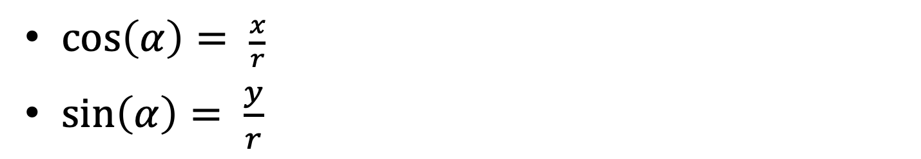

Calculating circle positions
$\cos\left(α\right)= \frac{x}{r}$
$\sin\left(α\right)= \frac{y}{r}$
$$α$$

Slide 21
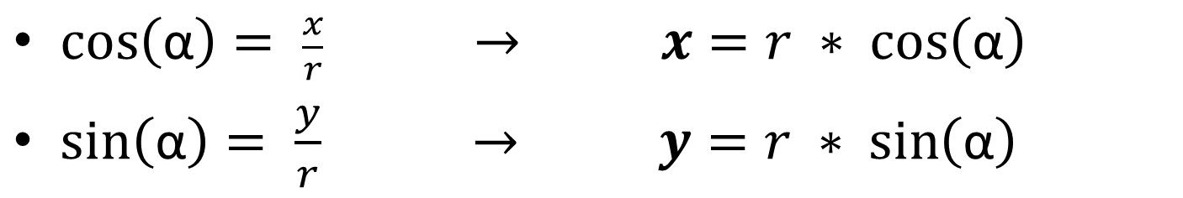
Calculating circle positions
$\cos\left(\text{α}\right)= \frac{x}{r} → x=r ∗ \cos\left(\text{α}\right)$
$\sin\left(\text{α}\right)= \frac{y}{r} → y=r ∗$ $\sin\left(\text{α}\right)$
$$α$$

Slide 22
Calculating circle positions
For drawing in Python, the convention is to take the rightmost point of the circle as the basis for the angle
1½π
π
0π / 2π
½π

Slide 23
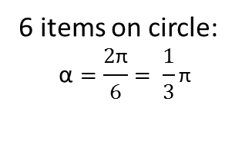
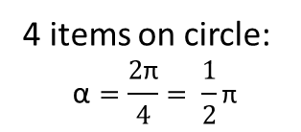
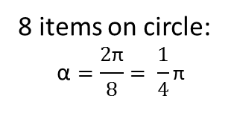
Calculating circle positions
The angle between items depends on total number of items in the circle
One anglesegment (α, the angle between two adjacent items on the circle) calculated for circles with varying positions:
α
α
α
4 items on circle:
$$\text{α}=\frac{2\text{π}}{4}= \frac{1}{2}\text{π}$$
6 items on circle:
$$\text{α}=\frac{2\text{π}}{6}= \frac{1}{3}\text{π}$$
8 items on circle:
$$\text{α}=\frac{2\text{π}}{8}= \frac{1}{4}\text{π}$$
$1 anglesegment=α=2$ $\text{π}$ / items on circle

Slide 24
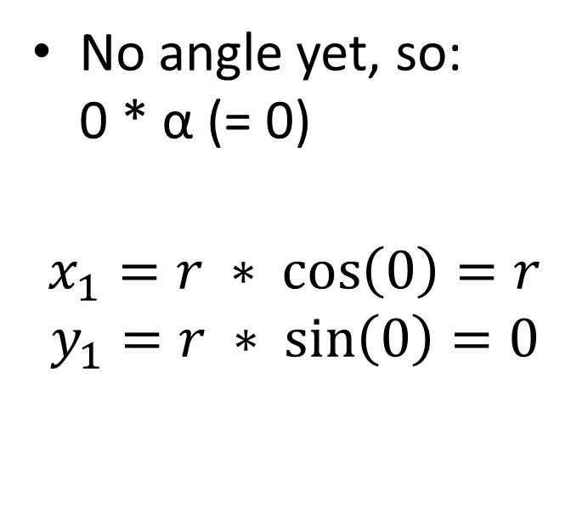
Calculating circle positions
First item on a circle
No angle yet, so: 0 * α (= 0)
$$x_{1}=r ∗ \cos\left(0\right)=r$$
$$y_{1}=r ∗ \sin\left(0\right)=0$$
(x₁,y₁)
r

Slide 25
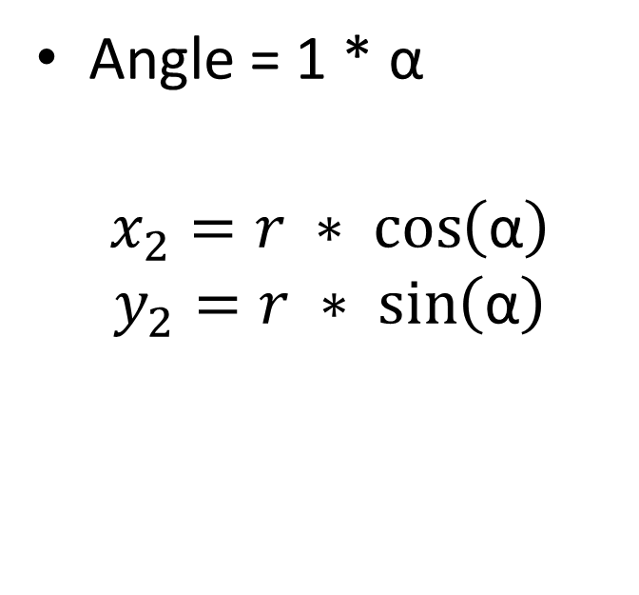
Calculating circle positions
Second item on a circle
Angle = 1 * α
$$x_{2}=r ∗ \cos\left(\text{α}\right)$$
$$y_{2}=r ∗ \sin\left(\text{α}\right)$$
r
α
(x₂,y₂)

Slide 26
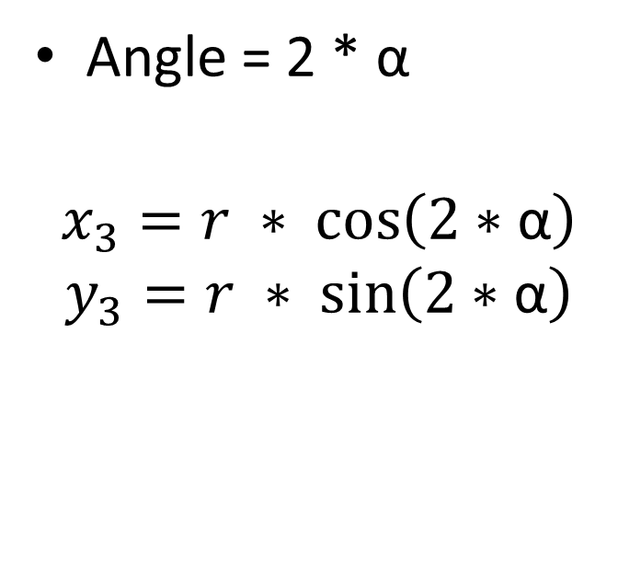
Calculating circle positions
Third item on a circle
Angle = 2 * α
$$x_{3}=r ∗ \cos\left(2∗\text{α}\right)$$
$$y_{3}=r ∗ \sin\left(2∗\text{α}\right)$$
r
α
2 α
(x₃,y₃)

Slide 27
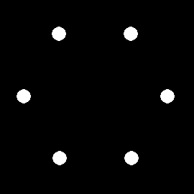
Calculating circle positions: python code
from math import pi, cos, sin my_canvas = canvas() r = 100 cx = 0 cy = 0 setsize = 6 anglesegment = 2*pi/setsize circlepositions = [] for i in range(0,setsize): x = r * cos(i*anglesegment) + cx y = r * sin(i*anglesegment) + cy circlepositions.append( (x,y) ) # Drawing to the circle positions for (x,y) in circlepositions: my_canvas.circle(x,y,10,fill=True)

Slide 28

Working with multiple inline scripts
Imagine you want to take different actions in your experiment depending on the response that participants have given.
You will have to add another inline_script item after the keyboard_response and logger items
To work with a given response in an inline script, you can only use the run phase
var.response_keyboard_response

Slide 29
Example task
Imagine a task in which you would like to show a certain image depending on the response of the participant:
If participant pressed 1 you want to show “scaryImage.jpg” at the center of the screen
If participant pressed 2 you want to show “neutralImage.jpg” at the center of the screen
If participant pressed 3 you want to show “funnyImage.jpg” at the center of the screen
(all these files are available in the file pool)
Note:
if the given response is a letter, the retrieved variable will be automatically converted to type string
if the given response is a number, the retrieved variable will be automatically converted to type integer
Make sure you set allowed_responses in keyboard_response to only register presses of the keys you want the participant to press.

Slide 30
Code in handle_response
Run phase:
given_response = var.response_keyboard_response
cnvs = canvas()
if given_response == 1:
cnvs.image(var.get_file(“scaryImage.jpg”))
elif given_response == 2:
cnvs.image(var.get_file(“neutralImage.jpg”))
elif given_response == 3:
cnvs.image(var.get_file(“funnyImage.jpg”))
cnvs.show()

Slide 31
Other useful variables
Other useful variables you might need to use in future tasks:
Response time: response_time_keyboard_response
Correctness : correct_keyboard_response
Note: the “keyboard_response” part will vary with the name you gave the response item. If you named it measure_resp for instance, all variables will end with this name (e.g. correct_measure_resp).
This is useful because you can also have multiple response items and this way you can distinguish them.

Slide 32
Almost there now…
Just a few more things left to talk about:
Conventions
“Unwritten agreements” or guidelines on how to write a good program
Debugging
Tracking down and solving problems or unexpected/undesired behavior of your program

Slide 33
Conventions
The most important aspect of a program is, of course, that it works and does what it is supposed to do.
However, a working program is not necessarily a “good” program.
Good program:
Concise
Powerful: do a lot of work with few statements
No spaghetti: endless threads of if-else statements
Economical with available resources (memory, processing power, etc.)
Readable/understandable for others and future you!

Slide 34
Conventions
As long as you use the correct syntax, Python is quite unrestrictive in how to structure your program
You can use any variable name from 1 to n characters
You can import modules anywhere in your program, right before you use them
You can place functions anywhere in your program
etc...
Still, even though it is possible, doesn’t mean you should do all these things

Slide 35
Conventions
To streamline/standardize the process of programming, there are agreemeents on what properties a good program should have
These are programming conventions
In a nutshell, there are conventions about
What to place where in your program
Commenting
Naming of variables, functions, etc
By following these conventions you will increase your comprehension of what’s going on in your own program and will make finding bugs a lot easier!

Slide 36
General structure of a program
Place items in the following order
Import statements
(in OpenSesame, modules that are used from inside a function should be imported in the function; otherwise, importing outside the function is more common)
Functions
Important variables
variables that will be used a lot in your whole program
var.
Canvases
Lists from which values are randomly picked (e.g. colorPool)
Penwidth used for many elements #constants
Radius of circle/elements to be drawn
The main program
Var. Statements to log your variables

Slide 37
Conventions: variable names
A variable can have any name but has to start with _ or a letter (numbers are not allowed)
Variables can start with a capital, but the convention is that they start with a lower case character
When using multiple words in a variable, separate them using snake_case (with underscores) or camelCase: start every word with a capital (except the first of course)
this_variable_ has_multiple_words thisVariableIsInCamelCase

Slide 38
Conventions: function names
A function does something, so the convention is to start a function’s name with a verb
drawStimulus
makeGrid
calculateCirclePositions
Note however that Python is not very strict with this convention itself (len(), input(), sum())

Slide 39
Comments
Use comments throughout your program to explain each important step.

Slide 40
Function documentation
Python allows you to put a multi-line string as the first item in your function (also called a docstring)
In this string you can explain what the function exactly does and in which format the arguments should be proved (string, number, etc.)
No need to make docstrings for your functions during your exam!
def drawDiamond(canvas, x, y, d=10, color="white", penwidth=5):
""" Function that draws a diamond at (x,y). The arguments are:
canvas (openexp.canvas object) - the canvas to draw to
x (int) - the x coordinate of the center of the diamond
y (int) - the y coordinate of the center of the diamond
d (int) - the distance of each vertex representing the diamond's corner to its center (default: 10)
color (string) - the color in which the diamond will be drawn (default: black)
penwidth (int) - the thickness of the lines with which the diamond is drawn (default: 5)
"""
old_penwidth = canvas.penwidth # Store old penwidth to restore later
canvas.set_penwidth(penwidth) # Set penwidth for drawings below
…

Slide 41
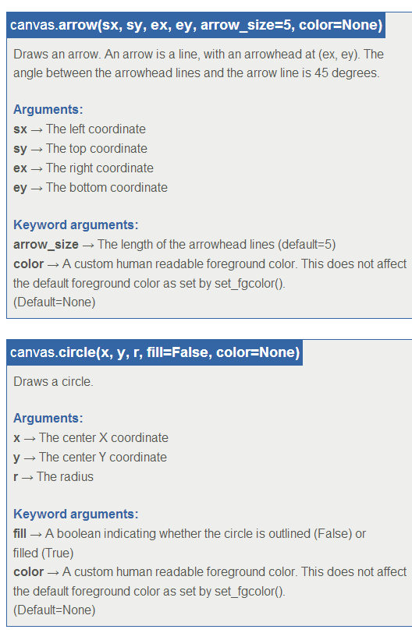
Function documentation
If you do this consistently, Python can automatically create pages like you’ve seen on osdoc.cogsci.nl from your docstrings
This might be useful at a time other people want to use one of those magic functions you wrote

Slide 42
Why use comments?
Useful for other people that want to reuse (parts) of your program, and maybe alter some things here and there
They don’t have to figure out endlessly what your code exactly does if it’s just written there in natural language beside it
Useful for future you if you ever need to reuse parts of your old programs
Six months later, you might not know anymore what your code was all about
Good commenting will earn you bonus points on the exam!

Slide 43
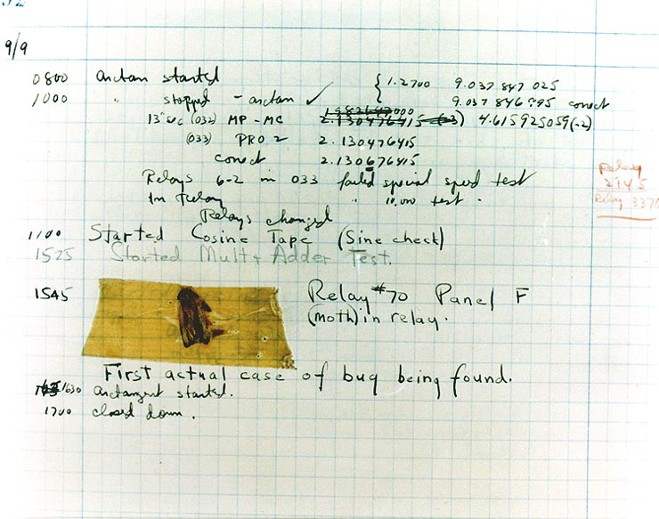
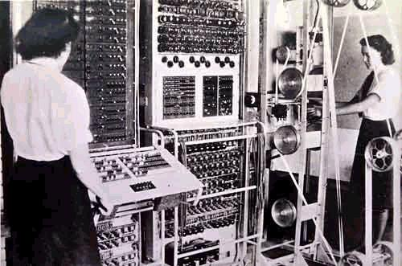
Bugs
First “bug” found in 1947 at Harvard University. Mark II Aiken Relay Calculator malfunctioned because of a real bug (a moth) inside its electronics, and had to be ‘debugged’.

Slide 44
Bugs
A software bug is the common term used to describe an error, flaw, mistake, failure, or fault in a computer program or system that produces an incorrect or unexpected result, or causes it to behave in unintended ways.
Every program contains bugs (yes, even the good or working ones!), but most of them are not annoying or rarely occur (e.g. millennium bug)

Slide 45
Debugging
Process of tracking down erroneous code in a program and correcting/removing it
Debugging can be a tedious job, escpecially with the complexity and size of modern programs, and with ‘distributed algorithms’ (many programs that co-operate)
Whole books have been written about debugging techniques/tools

Slide 46
Three type of ‘bugs’
Syntax errors
Runtime errors
Semantic errors

Slide 47
Syntax errors
The “easily solvable” bugs
Occur during ‘compilation’ of your program (before it actually starts running)
Usually consist of simple mistakes like typos or faulty statements
Often a line number is given by the compiler, along with the error message
The error messages a compiler gives can be quite cryptic sometimes
Sometimes line numbers are incorrect and the bug has to be found elsewhere (usually earlier) in the program
Always check the line before the indicated one, if you cannot find the error there

Slide 48
Syntax errors
Incorrect line numbers for (x,y) in positions: my_canvas.rect(x,y ← forgot closing ‘)’
Providing wrong data types to functions also often give wrong line indications
def printItem(list, number):
print list[number] ← Error indicated to occur on this line
printItem(5,6) ← Here the error is made, as an integer is passed where a list is expected in the func

Slide 49
Syntax errors
Common syntax errors
Forgetting a colon : after for, while, if, or def
Absent or non-matching string quotes
Unclosed opening operator ( { [ …
= instead of == inside a conditional statement
Indentation (!)
If someVariable == True: doSomething() ← indentation
Don’t use reserved Python “keywords” for variable names
and, del, from, not, while, as, elif, global, or, with, assert, else, if pass, yield, break, except, import, print, class, exec, in, raise, continue, finally, is, return, def, for, lambda, try

Slide 50
Runtime errors
Errors that occur after your program compiled without problems and is run.
If you’re lucky: error message occurs at start of the program, while arrays are being filled or variables are being referenced
If you’re unlucky: the error occurs somewhere else in the program (in the worst case near the end after which the program is aborted and some data might be lost).

Slide 51
Runtime errors
Common runtime errors
TypeErrors (a.k.a. referencing errors)
a = 25 b = “I am a string” print a + b
IndexError
nums = [1,2,3] print nums[3]

Slide 52
Semantic/logical errors (the big bosses)
Errors that do not crash the program (they don’t result in a report during compilation or during runtime), but simply make the program show unwanted/unexpected behavior
Usually occur as a consequence of incorrect logic in a conditional or incorrect arithmetic
These are very nasty to find (sometimes it can take a day or two)

Slide 53
Semantic/logical errors (the big bosses)
Incorrect arithmetic:
Convert to degrees:
Tc = 5/9*Tf-32 → 72F = 8C ?
Tc = 5/9*(Tf-32) → 72F = 22C
Incorrect logic if x > 5 and < 10: dotInBox = True
→ if x > 5 and x < 10: dotInBox = True

Slide 54
Semantic/logical errors (the big bosses)
!!! Indentation !!!
Always (and often) check if code that should be included in a if, for, while statement is indented!
If you make a mistake in this, your program might run normally, but will not do what it should do
def stringReverse(myString): revString= ""
for n in range (len(myString)-1,-1,-1): revString+=(myString[n])
print revString ≠
def stringReverse(myString): revString= ""
for n in range (len(myString)-1,-1,-1): revString+=(myString[n])
print revString
Code that belongs to function
Code that belongs to function

Slide 55
Semantic/logical errors (the big bosses)
Infinite loops
A loop of which the conditional statement never becomes False
Your program will get stuck at this point and run forever
while x < 200: ← Keeps running if x < 200 x = random.randint(0,150) ← x cannot get above 150 y = random.randint(0,300)
drawDot(x,y)

Slide 56
How to solve bugs
Use information in error message to track down location of bug (line no., type of error, etc.)
Be concise with coding (train ‘an eye’ for correct syntax: colons, indentation)
Your hero: print()
Use the print statement often
Prints values to command line / console

Slide 57
Print examples
n=0
total = 0
while n != 15: total += n n += 2
Infinite loop! Why does this occur? Use print to get behind this
while n != 15: total += n n += 2 print n
2 4 6 8 10 12 14 16(!) (15 never occurs)

Slide 58
Print examples
Sometimes a value is not what it should be, but it is hardly visible when using print: line = “horizontal “ if line == “horizontal”: ← Never happens due to “ “! # do stuff
‘print line’ will just show “horizontal” (it prints the space, but you won’t see that)
Solution: add a visible character in front an behind the printed variable print “>” + line + “<“ >horizontal < ← Space visible

Slide 59
Useful guidelines for debugging
Know (the goal of) your program
What does it do?
What should it do?
Change one thing at a time
If you change more things at once you will not discover the real sole cause of your trouble(s)
Reproduce the problem
If you get a not understandable error message and know the location of the error, try to see if a change to that line will result in a different error message
The problem is not gone until you fixed it
When it stops occurring when you haven’t done anything, it is still there and will happen again!
Take a rest and stop after a while with no results
Ask for help!
Someone else might have seen your bug before (and squashed it)
Test, test, test

